Slide 1
MyAnimeList Tableau Visualization
Jonathan Kang
Source: MyAnimeList
https://myanimelist.net/

Slide 2
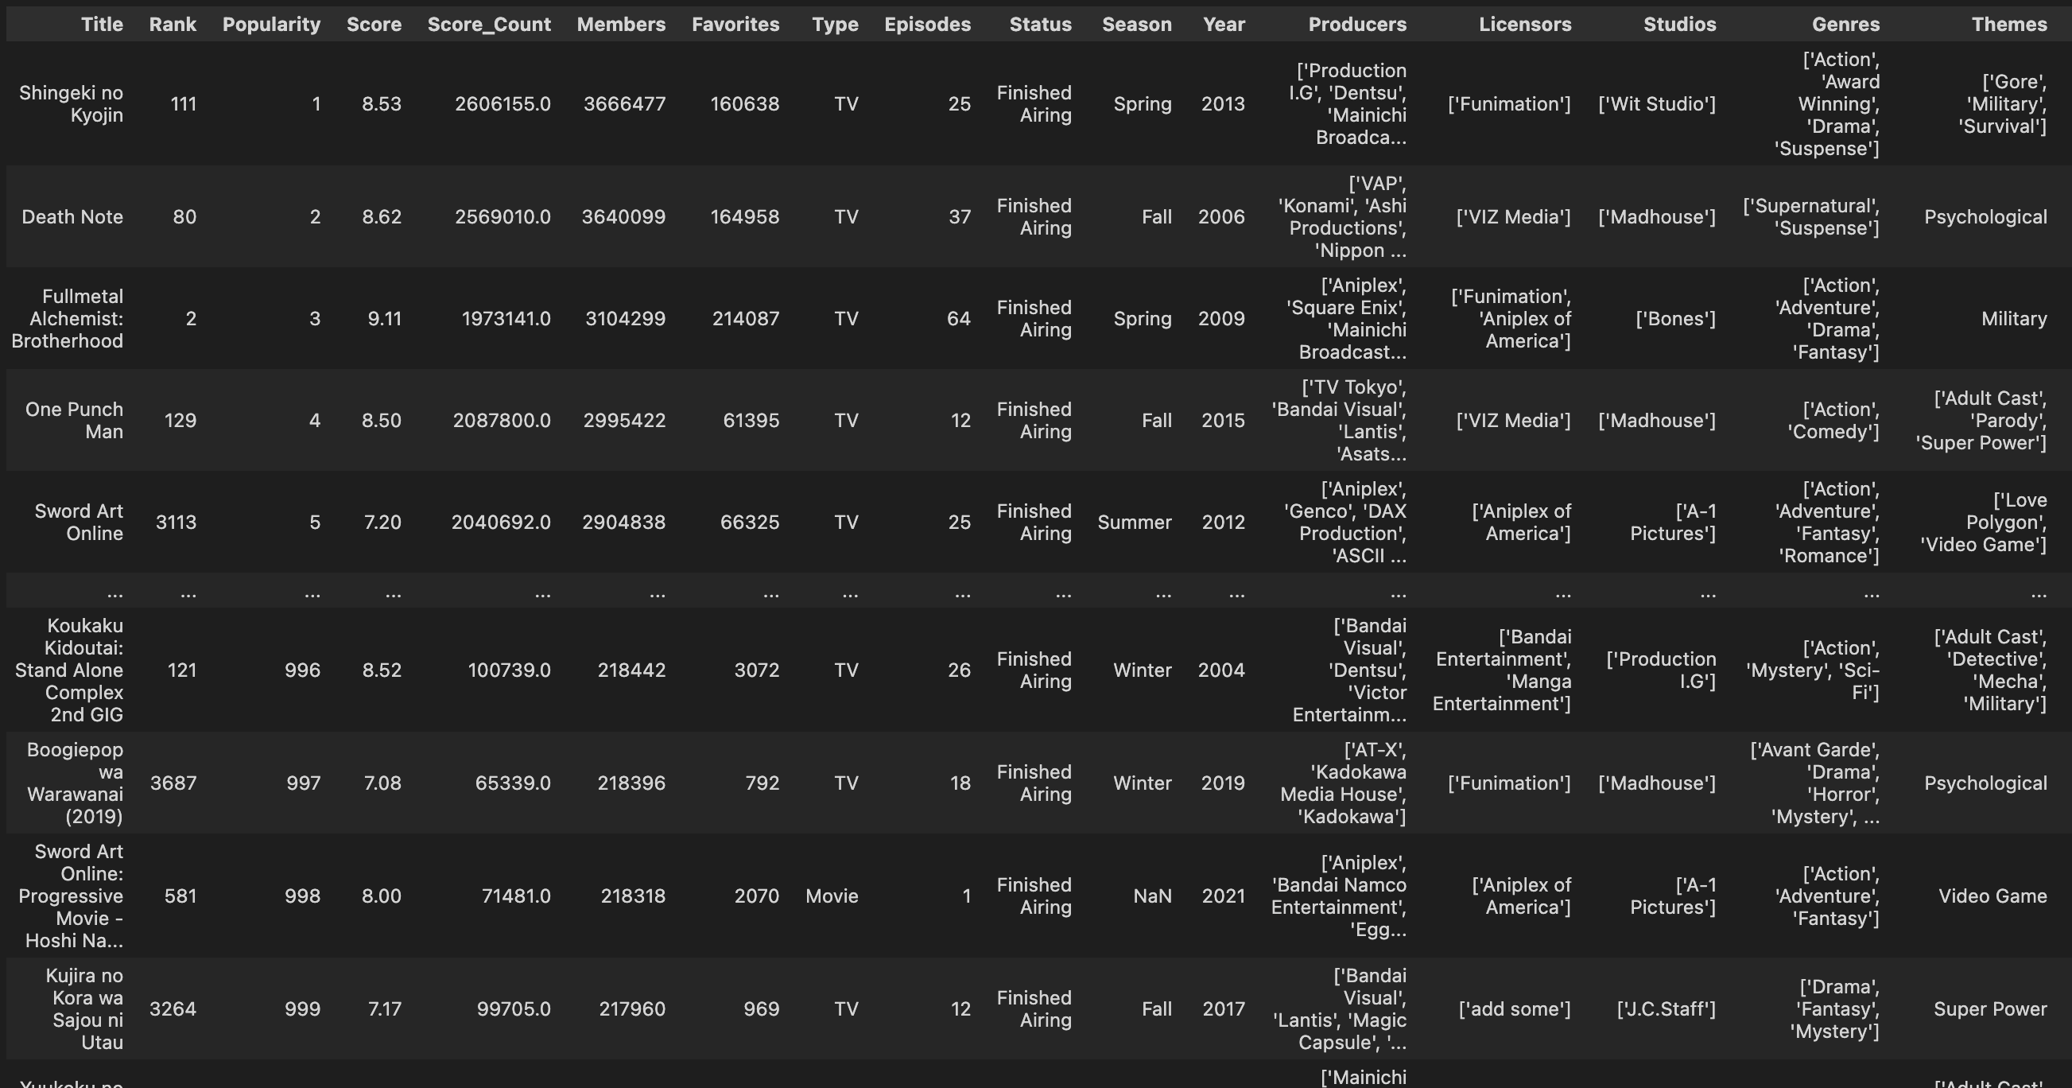
Introduction
With Anime gaining more popularity among the Western community since COVID, I began wondering what are some of the characteristics of the current most popular shows and are there any interesting trends that are showing.
To analyze this information, I have scraped data from MyAnimeList using BeautifulSoup, obtaining the top 1000 anime shows by popularity and by rating (we will focus on popularity for most graphs). Data is gathered on March 9 and 10.
Pandas were then used to clean and generate new helpful calculations. Data is then finally visualized using Tableau.
Code for scraping and cleaning can be found on the same GitHub repository.
Snapshot of the resulting concatenated dataset of the top shows

Slide 3
TLDR Summary
Q: Any shows that were extremely popular but scored very low?
There were two shows that satisfy this description: "The Promised Neverland Season 2" and "School Days".
Q: Outstanding genres and studios?
From the charts, we can see that most common genres (Action, Comedy, Romance, etc.) had lower ratings, while the less common genres had higher ratings. The least rated genres were "Ecchi" and "Erotica". Regarding the studios, "Madhouse" and "Bones", followed by "Production I.G." and "Kyoto Animations", have produced the highest number of popular shows with an overall high rating compared to other studios.
Q: Any trends in the popularity of titles by the year?
Interestingly, there seems to be a somewhat inverse relationship between the number of titles and the average rating given by users. When the number of popular titles increased, the average rating for all shows followed a decreasing trend. Similar trends were exhibited vice versa. Although the recent couple of years show a slight dip in the proportion of members who have rated the title, the overall percentage seems to remain constant for the most popular and highest-rated shows.
Q: Do the number of licensors affect the number of members per title?
Upon observation, we noticed that as the number of members was declining, the number of titles and licensors was also declining. However, the rate of which members were declining was at a similar rate to the number of licensors, while the general pattern matched the number of titles per year.
Q: Is there any signs of COVID impacting the number of popular shows?
One fascinating point between 2020 and 2021 is the sudden increase in popular shows. Multiple animation studios faced a decline in work productivity due to COVID, causing delays in the production of animation. Though it is difficult to establish a direct relationship, the additional time received by studios may be positively correlated with the quality of animations for the following seasons.

Slide 4

Tableau Visuals
The following graphics are plots and dashboards built using Tableau to explore and analyze the cleaned data.
The focus of this study will be on finished tv anime shows.

Slide 5
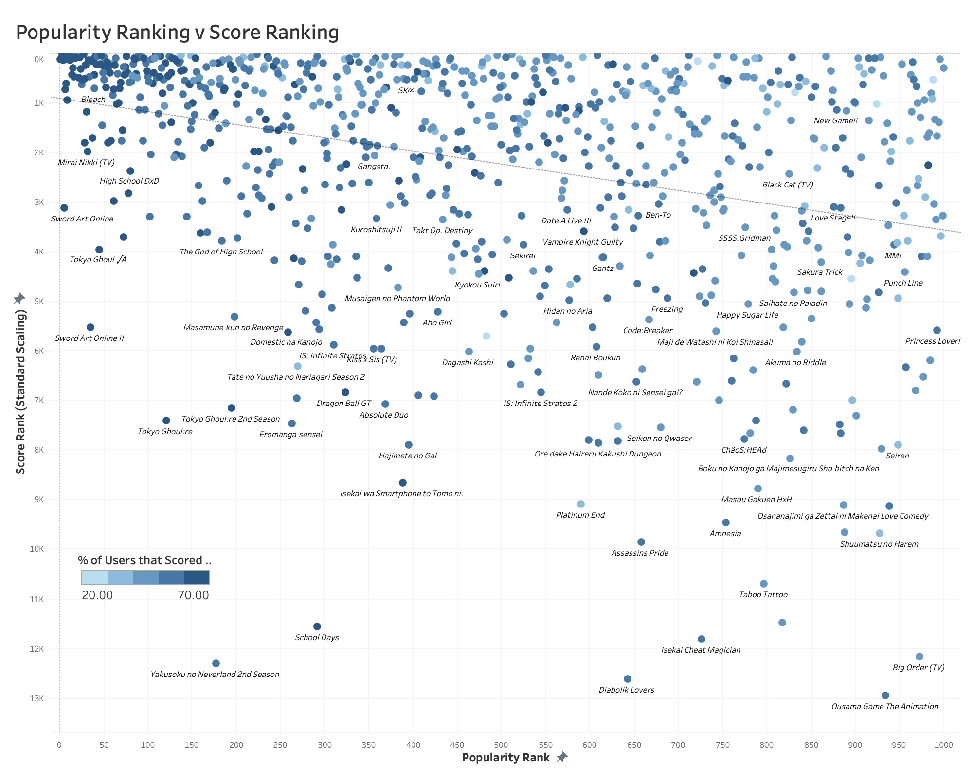
This is a simple scatterplot that shows how the various titles are distributed with the ranking of the score plotted against the popularity.
The shade of the of the point represents the proportion of members that have scored the show. The dotted line represents the line of best fit.
Using the standard scaling, this plot highlights outlying shows: Shows that are extremely popular but scored lowly by the community.

Slide 6
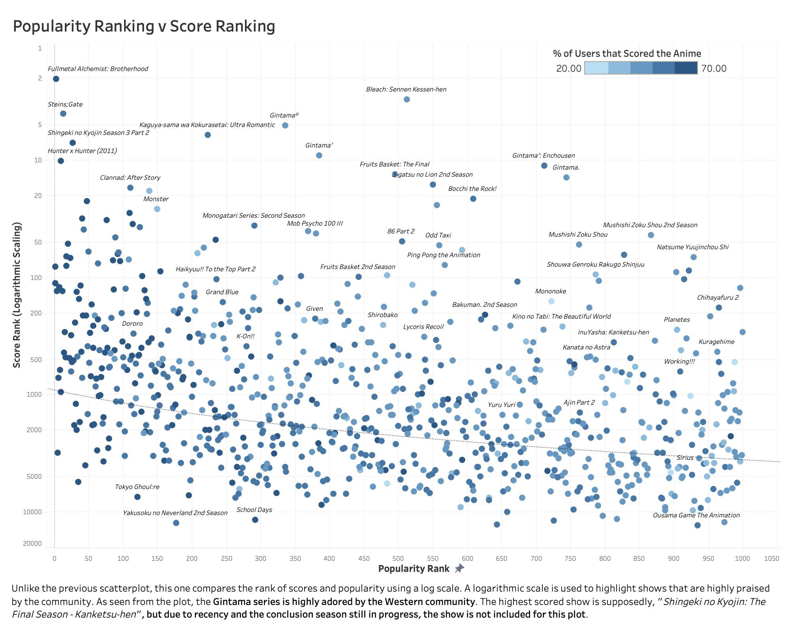

Slide 7
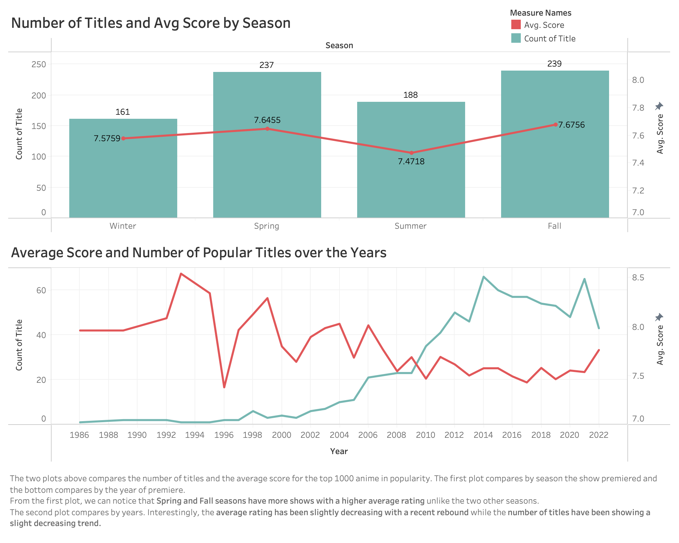

Slide 8
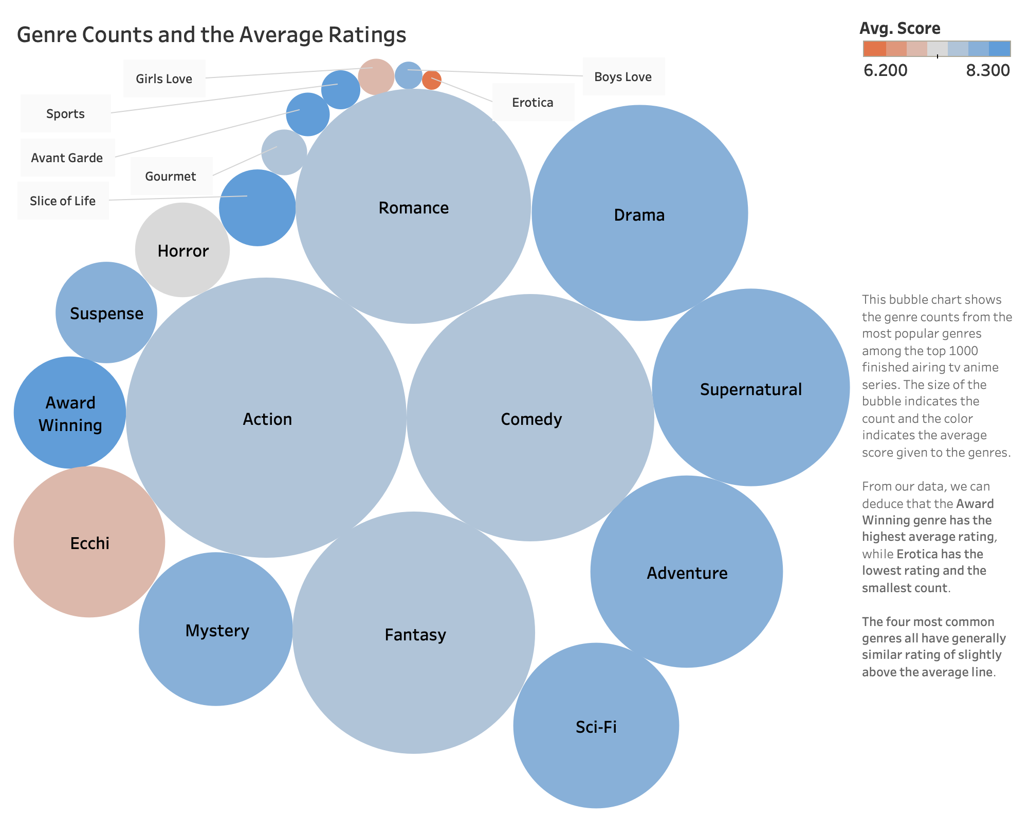

Slide 9
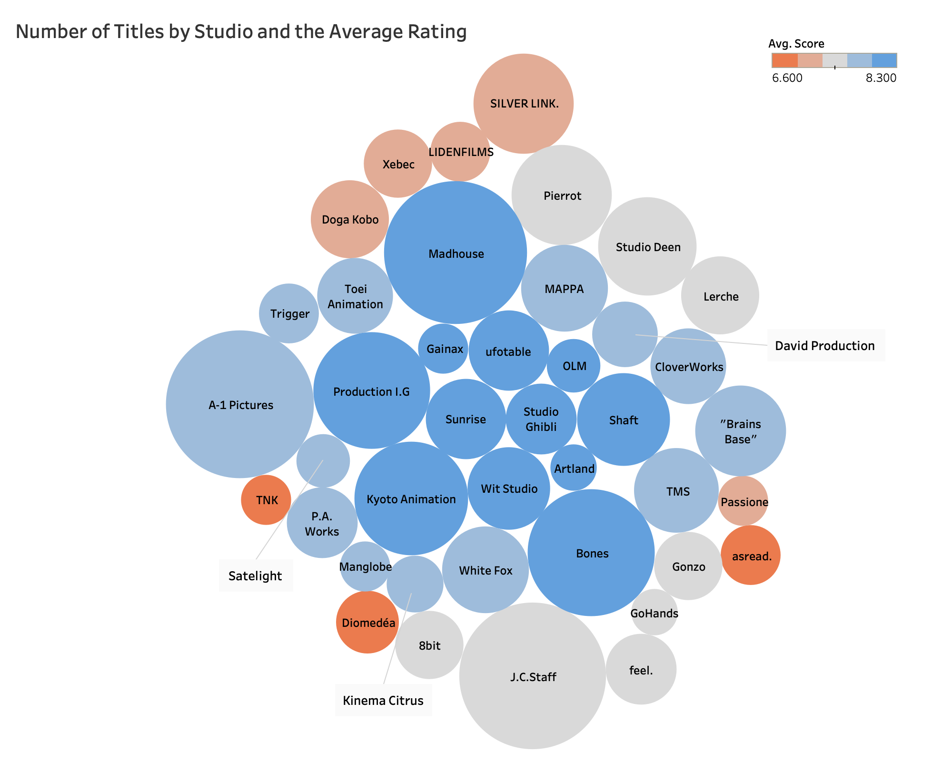

Slide 10
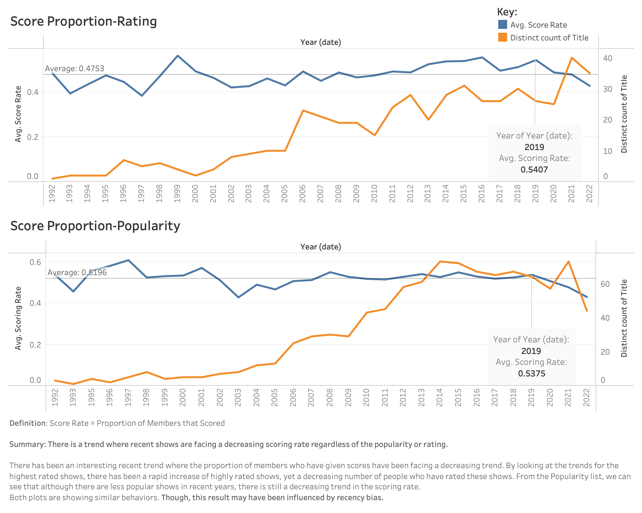

Slide 11
